Slide 1
Topics
Introduction and overview Components of the Web Architecture HTTP Protocol
Client-side Programming HTML CSS Javascript language and frameworks (JQuery, YUI, etc) Cross browser compatibility
Server-side Programming Introduction to web servers Request/Response cycle State management issues MVC Architecture Programming Technologies and Frameworks
Advanced Web Programming XML & JSON Web services Ajax patterns
Web Engineering Performance and scalability issues SSL Prevention from Sql Injection and cross-site attacks Internationalization & Localization
Emerging Trends

Slide 2
Assessment
Assignments/Quiz/Project 30 %
Mid Terms 30 %
Final 40 %
Total 100

Slide 3
History of the Web
Tim Bernes Lee - Weaving the Web
Sir Tim Berners-Lee is a British computer scientist. He was born in London, and his parents were early computer scientists, working on one of the earliest computers.
After graduating from Oxford University, Berners-Lee became a software engineer at CERN, the large particle physics laboratory near Geneva, Switzerland.
In March 1989, Tim laid out his vision for what would become the web in a document called “Information Management: A Proposal”
https://www.w3.org/People/Berners-Lee/Weaving/Overview.html
http://webfoundation.org/about/vision/history-of-the-web/
History Vedio

Slide 4
HTTP protocol

Slide 5
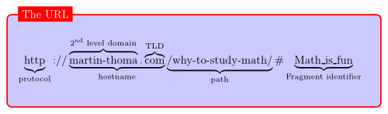
URL-Universal Resource Locator.
URLs are location dependant.
It contains four different parts:
The protocol type
The machine name
The directory path
The file name

Slide 6
HTML – Quick overview
<!DOCTYPE html>
<html>
<body>
<form>
First name:<br>
<input type="text" name="firstname">
<br>
Last name:<br>
<input type="text" name="lastname">
</form>
<p>Simple form to enter First Name and Last Name.</p>
</body>
</html>

Slide 7
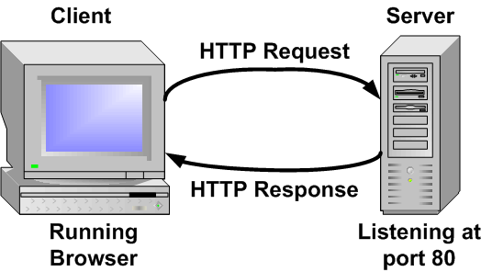
http protocol- request\response
The Browser send a request
The Server responds.

Slide 8
http- request
http method (the action to be performed)
The page to access (a URL)
Form parameters (like the arguments to a method)

Slide 9
http- response
A status code (for whether the request was successful)
Content-type (text, picture, HTML ect)
The content (the actual content, image, ect)

Slide 10
http request methods
GET
POST
DELETE
OPTIONS
CONNECT
HEAD
TRACE

Slide 11
http – get
GET is a simple request
Its job is to ask the server to get a resource and send it back.
The total amount of characters are limited in a GET
The data sent is appended to the URL

Slide 12
http request example
GET /select/student.jsp?name=Ali HTTP/1.1
User-Agent: Mozilla/4.0 (compatible; MSIE5.01; Windows NT)
Host: www.nu.edu.pk
Accept-Language: en-us
Accept-Encoding: gzip, deflate
Connection: Keep-Alive

Slide 13
http-post
POST request is designed to make complex requests
Example is that user might want form data to be added to the DB.
Data to be sent to the server is in “payload” or “message body”

Slide 14
http-post example
POST /cgi-bin/process.cgi HTTP/1.1
User-Agent: Mozilla/4.0 (compatible; MSIE5.01; Windows NT)
Host: www.tutorialspoint.com
Content-Type: application/x-www-form-urlencoded
Content-Length: length
Accept-Language: en-us
Accept-Encoding: gzip, deflate
Connection: Keep-Alive
licenseID=string&content=string&/paramsXML=string

Slide 15
http-response
A HTTP response has a header and a body.
Header tell about the protocol and if the request was successful and what type of content is included.
The body contains the content.

Slide 16
http-response example
HTTP/1.1 200 OK
Date: Mon, 27 Jul 2009 12:28:53 GMT
Server: Apache/2.2.14 (Win32)
Last-Modified: Wed, 22 Jul 2009 19:15:56 GMT
Content-Length: 88
Content-Type: text/html
Connection: Closed
<html>
<body>
<h1>Hello, World!</h1>
</body>
</html>

Slide 17
http-response example 2
HTTP/1.1 404 Not Found
Date: Sun, 18 Oct 2012 10:36:20 GMT
Server: Apache/2.2.14 (Win32)
Content-Length: 230
Connection: Closed
Content-Type: text/html; charset=iso-8859-1
<!DOCTYPE HTML PUBLIC "-//IETF//DTD HTML 2.0//EN">
<html>
<head>
<title>404 Not Found</title>
</head>
<body>
<h1>Not Found</h1>
<p>The requested URL /t.html was not found on this server.</p>
</body>
</html>

Slide 18
Questions ?

